Slide 2
Winter Water Safety Stay safe in winter – the dangers of frozen waters In winter, children and pets are particularly at risk when tempted to play on the ice formed on open water, and adults can find themselves at risk in attempting to save them. Taking a nice walk-in cold weather with your family, friends or dogs in tow can be really refreshing, just make sure you know some simple tips on how to stay safe in winter. Areas with frozen lakes, ponds, canals and reservoirs can be beautiful places to visit during the winter months but all too often many people risk their lives by venturing onto frozen water. Here are some useful tips to help you know what to do in an emergency.

Slide 3
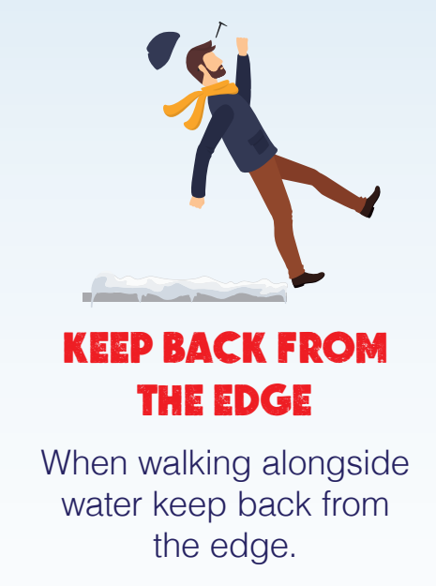

Slide 4
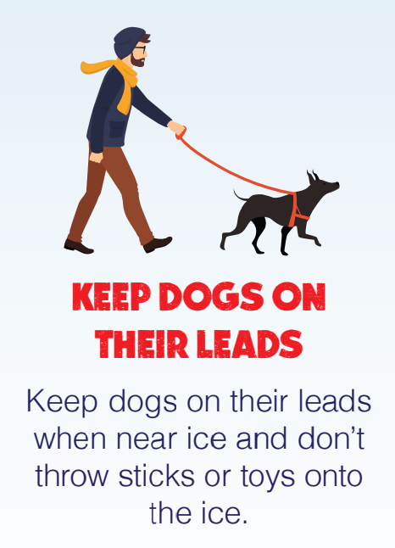

Slide 5
